Slide 1
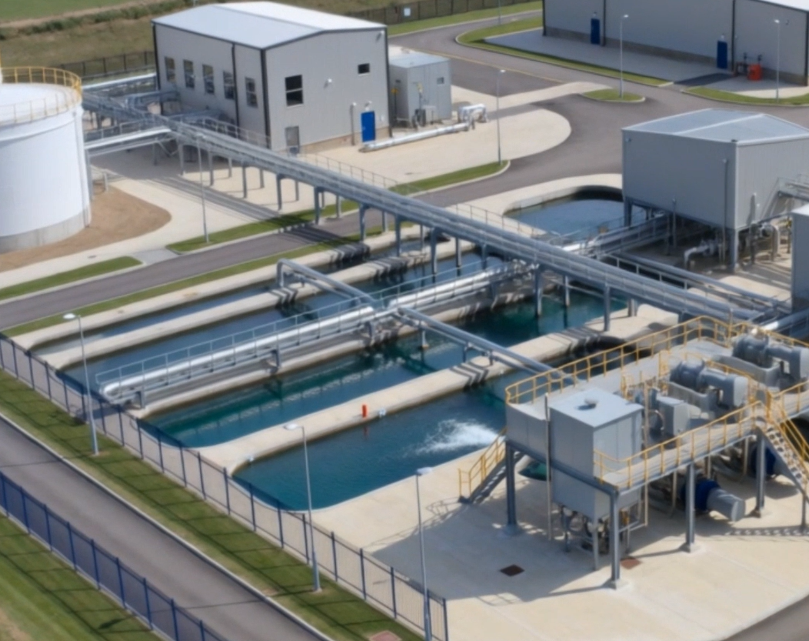
Security-Informed Safety
Episode 1
Hazard-Threat Convergence in Municipal Water Treatment
CyBOK Funded Project
Author: Dr Hossein Abroshan

Slide 2
Learning Outcomes
After completing this episode, students should be able to:
Explain the importance of pH control in municipal water treatment.
Describe how OT components interact within a water treatment process.
Explain how cyber compromise can influence physical processes.
Identify hazards, unsafe control actions, and potential harm.
Explain the role of independent safety functions.
Apply Security-Informed Safety principles to industrial environments.

Slide 3
Municipal Water Treatment Process
Water Treatment and pH Control
Water treatment depends on accurate process control.
Sodium hydroxide is used to maintain pH within acceptable limits.
Sensors, controllers, pumps, and operators work together to maintain safe operation.
Deviations in chemical dosing can create hazardous conditions.

Slide 4
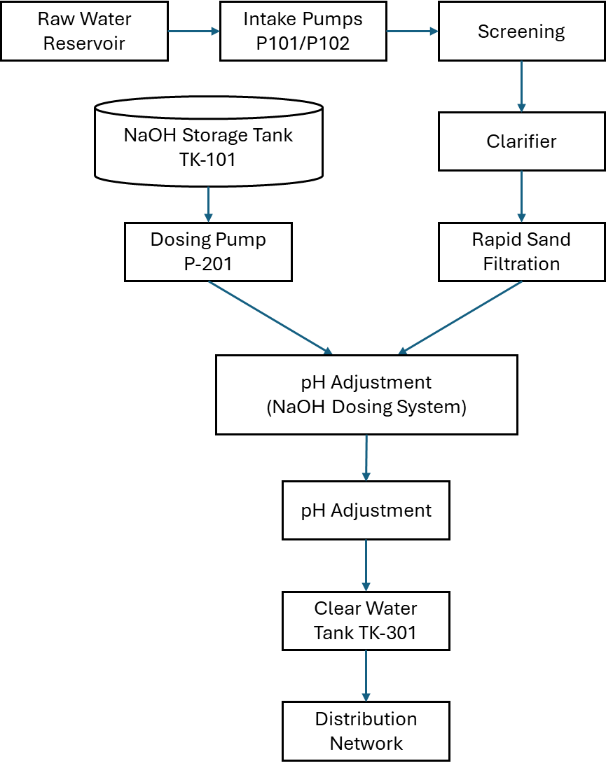
Municipal Water Treatment Process Overview

Slide 5
Normal Control Architecture
OT Control and Monitoring
Process measurements are collected continuously.
PLC-201 controls sodium hydroxide dosing.
SCADA and HMI systems provide operational visibility.
Engineering workstations support maintenance and configuration activities.
Remote access enables authorised support activities.

Slide 6
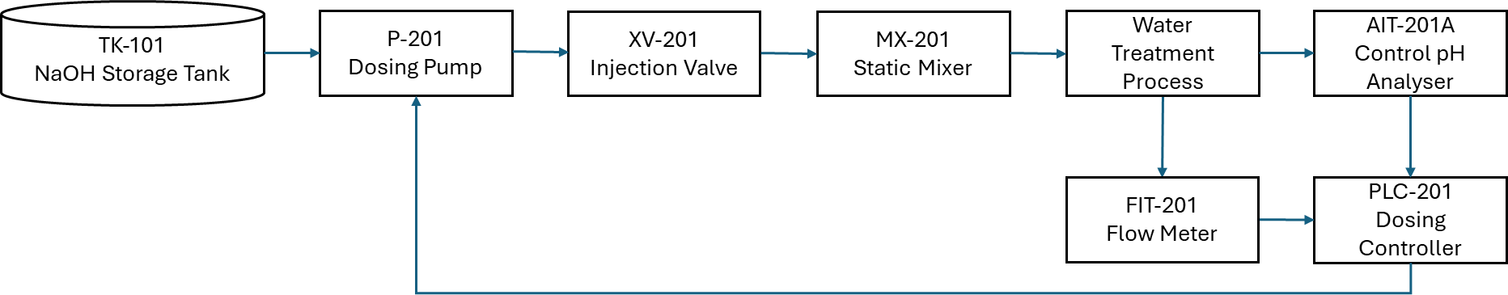
Sodium Hydroxide Dosing Control Loop

Slide 7
Attack Path Through the OT Environment
Compromise of a Trusted Maintenance Pathway
Contractor maintenance access is authorised.
Engineering workstations have privileged access.
PLC configuration can influence physical processes.
Trust relationships become security dependencies.

Slide 8
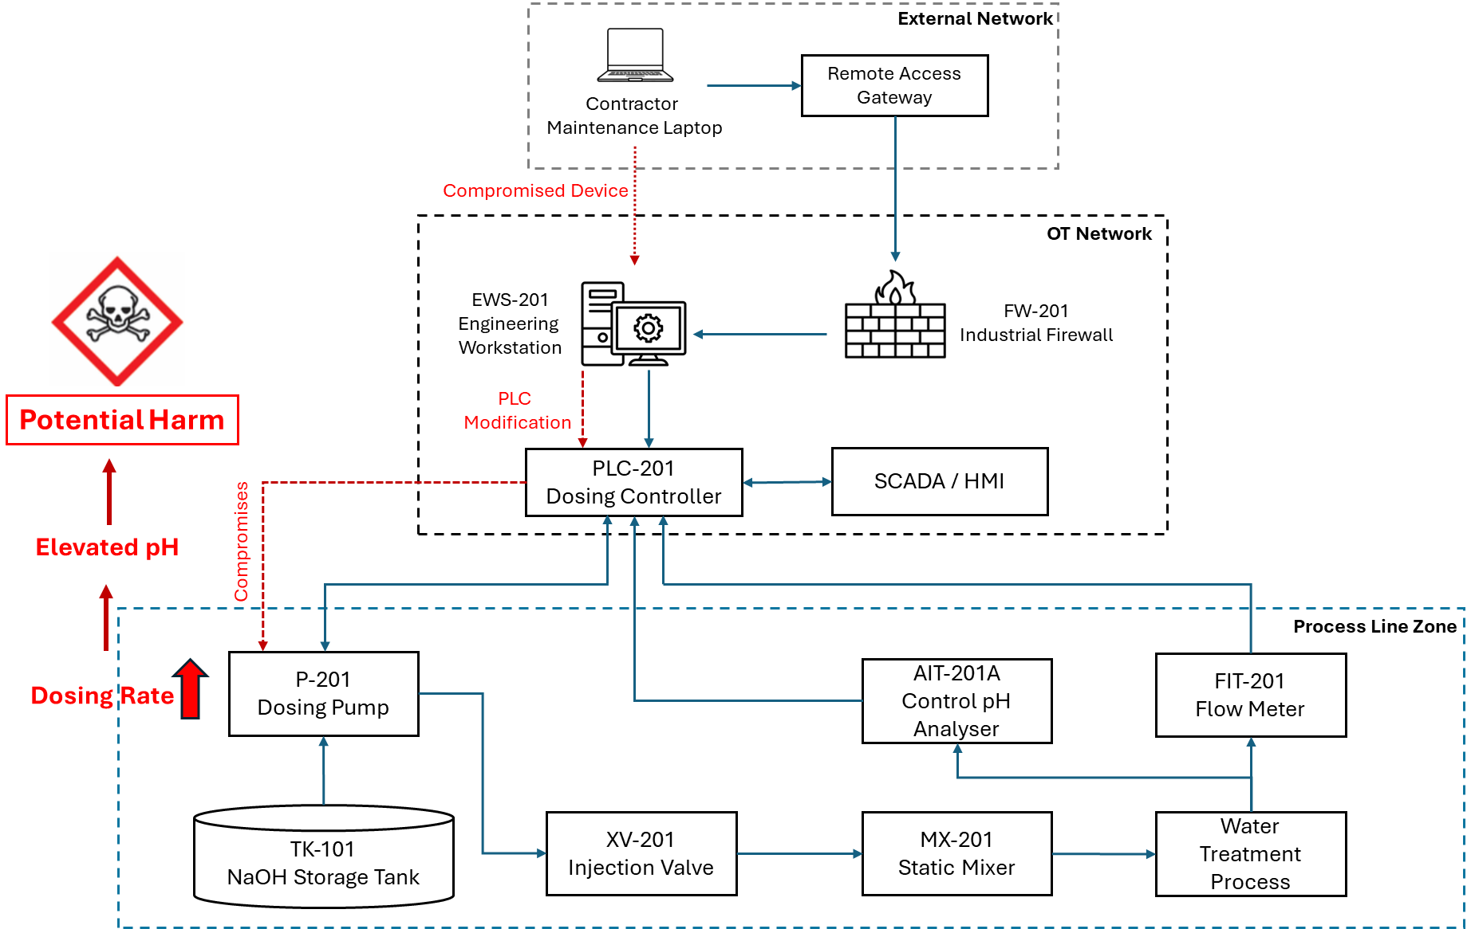
OT Architecture and Attack Path

Slide 9
Cyber-to-Physical Escalation
From Cyber Compromise to Process Hazard
Compromised Maintenance Device
Engineering Workstation Access
PLC Modification
Excessive Sodium Hydroxide Dosing
Elevated pH
Potential Harm
Discussion Question
Where does the cyber security incident become a safety issue?

Slide 10
Independent Safety Protection
Safety Instrumented Function (SIF-201)
Independent pH measurement.
Independent Safety PLC.
Automatic protective action.
Dosing pump shutdown.
Isolation valve closure.
Prevention of further chemical injection.

Slide 11
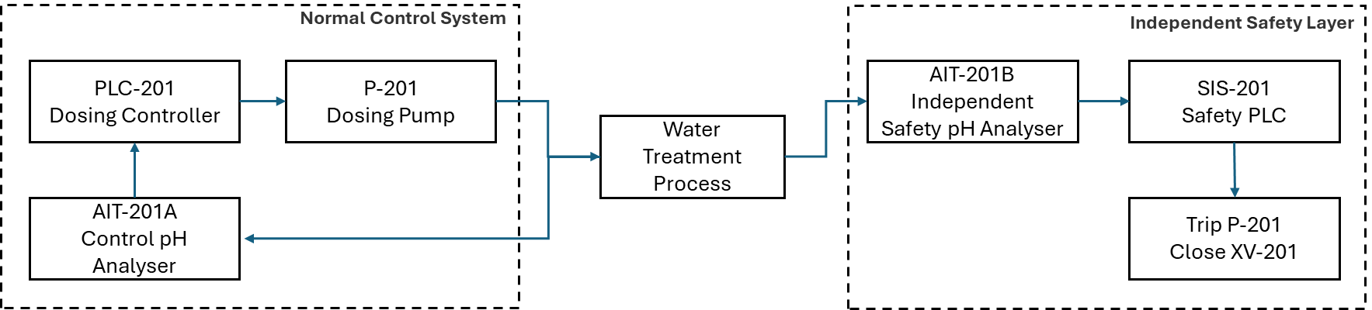
OT Architecture and Attack Path

Slide 12
Security-Informed Safety
Key Lessons
Cyber events can influence physical processes.
Hazards emerge when process behaviour changes.
Cyber security reduces the likelihood of compromise.
Safety systems reduce the consequences of failure.
Neither cyber security nor safety alone is sufficient.
Security-Informed Safety Principle
When cyber security works, hazards are prevented; when cyber security does not, safety systems reduce the consequences.
Discussion Questions
What was the hazard?
What was the potential harm?
Which controls were cyber security controls?
Which controls were safety controls?
How could resilience be improved?

Slide 13
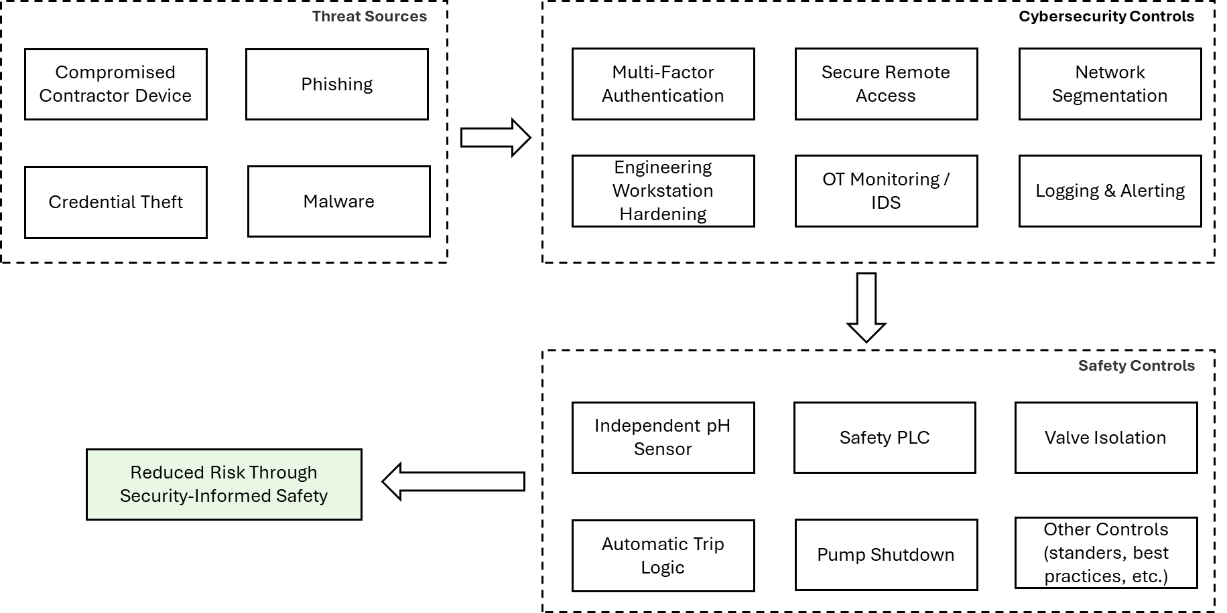
Security-Informed Safety Redesign

