Slide 1
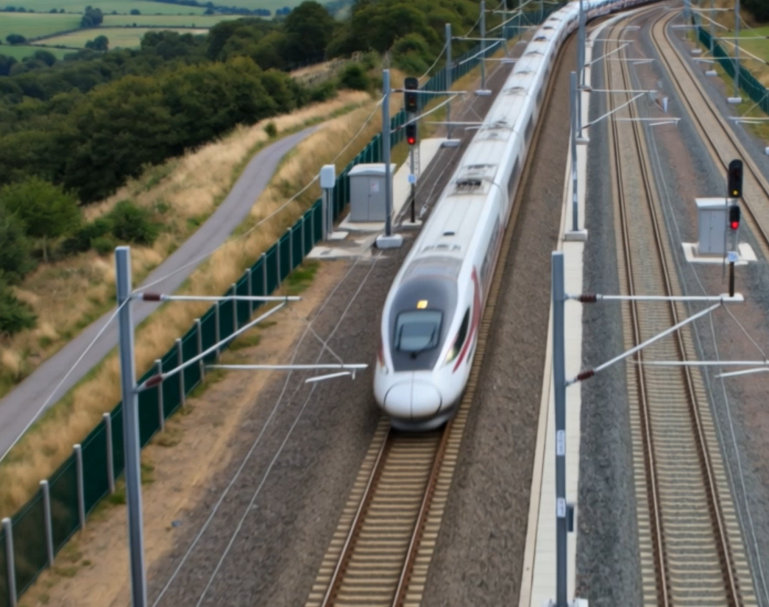
Security-Informed Safety
Episode 2
Railway Signalling Patch Leading to Near-Collision
CyBOK Funded Project
Author: Dr Hossein Abroshan

Slide 2
Learning Outcomes
After completing this episode, students should be able to:
Explain the purpose of railway signalling systems
Describe the operation of ETCS Level 2
Explain the roles of the RBC, interlocking, GSM-R and onboard ETCS systems
Understand the purpose of railway safety cases
Explain why software changes require safety assurance
Analyse how cyber security actions can influence safety-critical behaviour
Apply Security-Informed Safety principles to railway environments.

Slide 3
Railway Signalling and Train Separation
Why Train Separation Matters
Railway signalling prevents collisions and unsafe train movements.
Trains require significant distance to stop safely.
Movement Authorities define how far trains may proceed.
Multiple protection layers help ensure safe railway operation.
ETCS continuously supervises train movement.

Slide 4
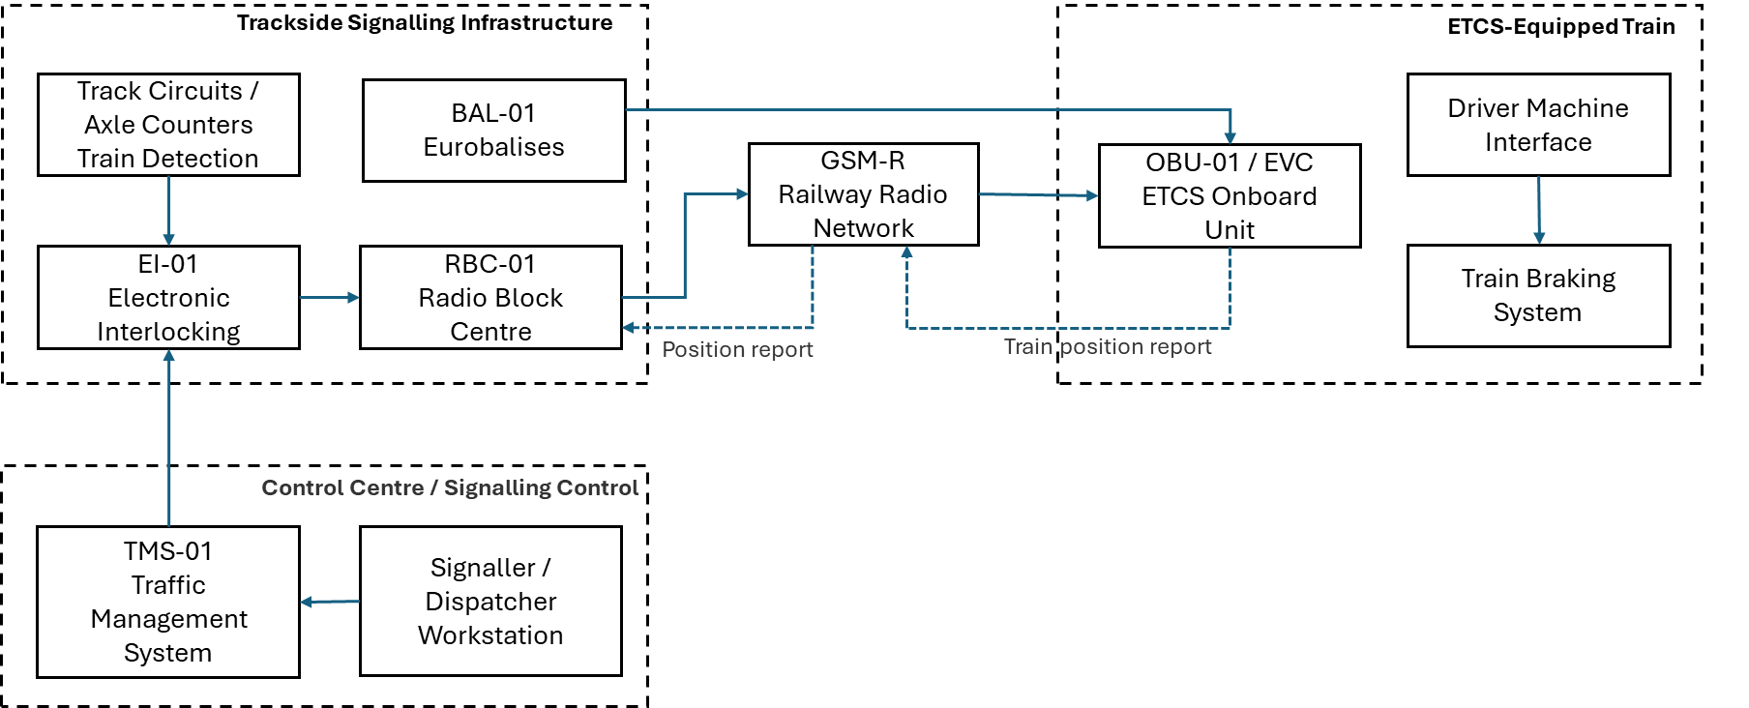
ETCS Level 2 Operational Architecture

Slide 5
Movement Authority and Braking Supervision
How ETCS Maintains Safety
Train reports position.
Interlocking confirms route availability.
RBC calculates Movement Authority.
Authority is transmitted via GSM-R.
Onboard ETCS calculates braking curves.
Continuous supervision protects train operation.

Slide 6
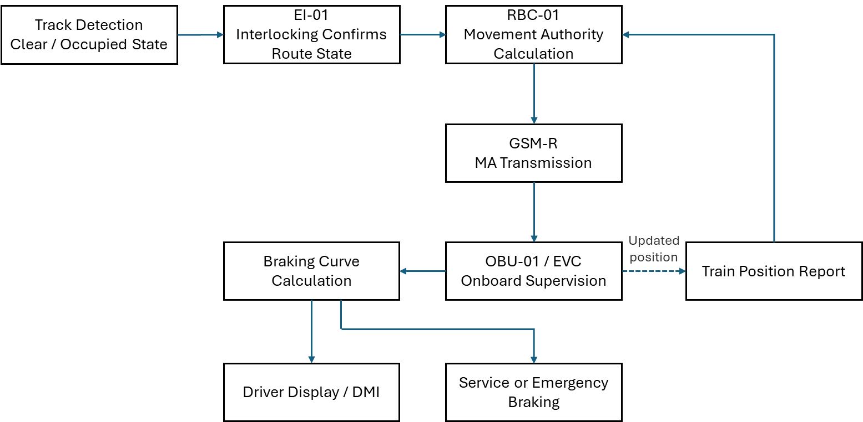
Movement Authority and Braking Supervision

Slide 7
Emergency Cyber Security Patching Scenario
The Challenge:
A cyber security vulnerability is discovered.
The vendor issues an urgent software patch.
Pressure emerges to deploy the update rapidly.
Initial testing confirms successful installation.
Full safety validation has not yet been completed.
Security-Informed Safety Principle
Reducing cyber security risk does not automatically reduce safety risk.

Slide 8
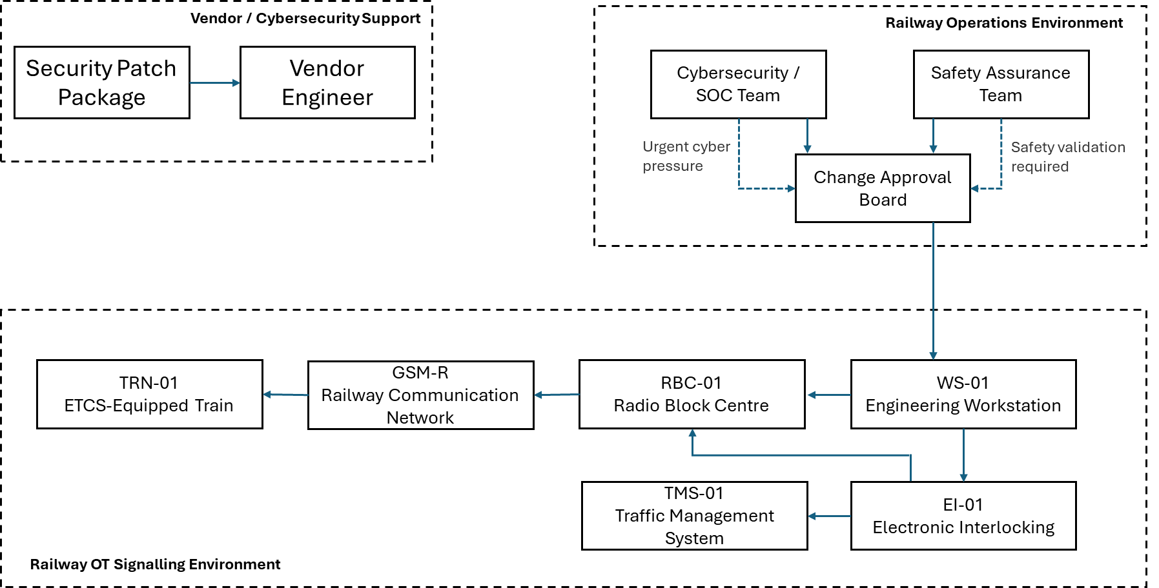
Railway OT Architecture and Patch Deployment Path

Slide 9
Cyber-to-Physical Escalation
From Cyber Compromise to Process Hazard
Security Vulnerability Identified
Emergency Patch Deployment
Incomplete Safety Validation
Unexpected Software Timing Behaviour
Delayed Movement Authority Updates
Reduced Train Separation Margin
Near-Collision Hazard
Discussion Question
At which point does a cyber security action become a railway safety issue?

Slide 10
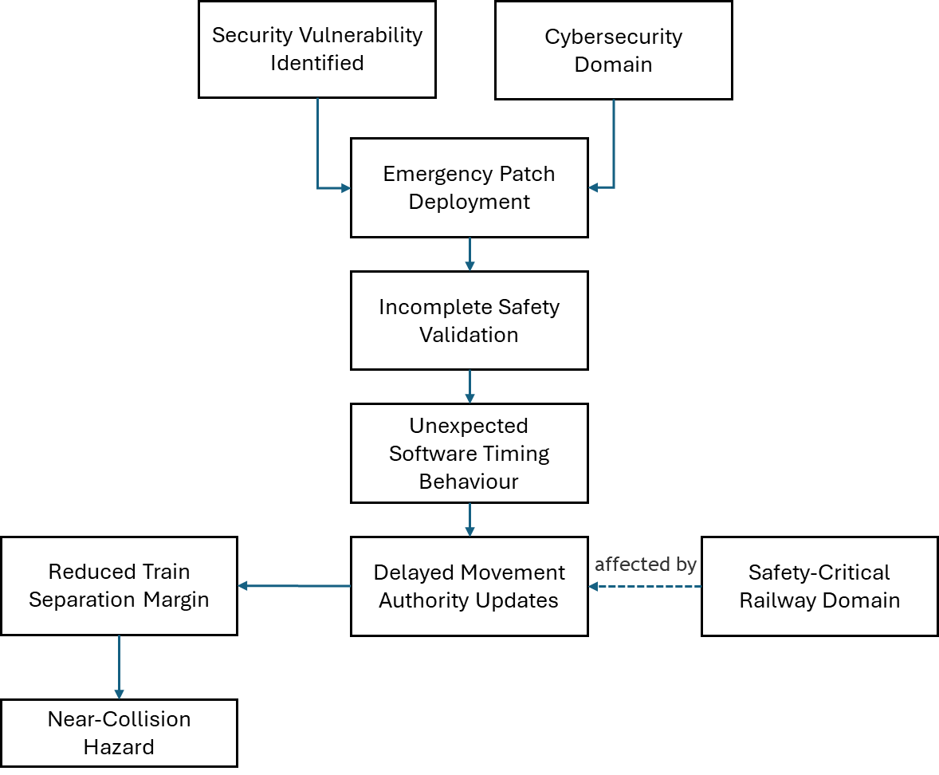
Cyber-to-Physical Escalation Pathway

Slide 11
Independent Safety Protection
ETCS Automatic Braking Intervention
Movement Authority updates are delayed.
Train separation margins become reduced.
Onboard ETCS continues monitoring train behaviour.
Braking curves are recalculated continuously.
Automatic braking is initiated.
The train stops safely before reaching the danger point.
Functional Safety Principle
Independent protection layers should remain effective even when other systems behave unexpectedly.

Slide 12
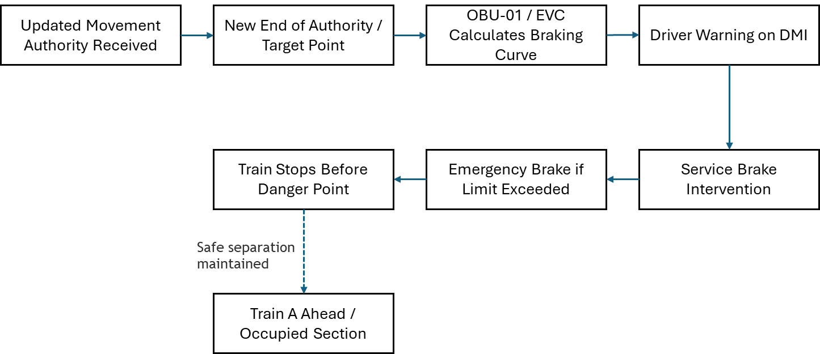
ETCS Automatic Braking Intervention

Slide 13
Security-Informed Safety
Key Lessons
Cyber security actions can have safety consequences.
Safety-critical systems require assurance beyond functional testing.
Timing failures can be safety-critical.
Emergency changes require careful governance.
Safety cases remain essential during cyber security incidents.
Defence-in-depth remains important.
Cyber security and safety teams must work together.
Security-Informed Safety Principle:
Cyber security objectives and safety objectives must be considered together when managing operational change.
Discussion Questions
What was the hazard?
What was the role of the safety case?
Which protection layers failed?
Which protection layers succeeded?
How could the patch deployment process be improved?

Slide 14
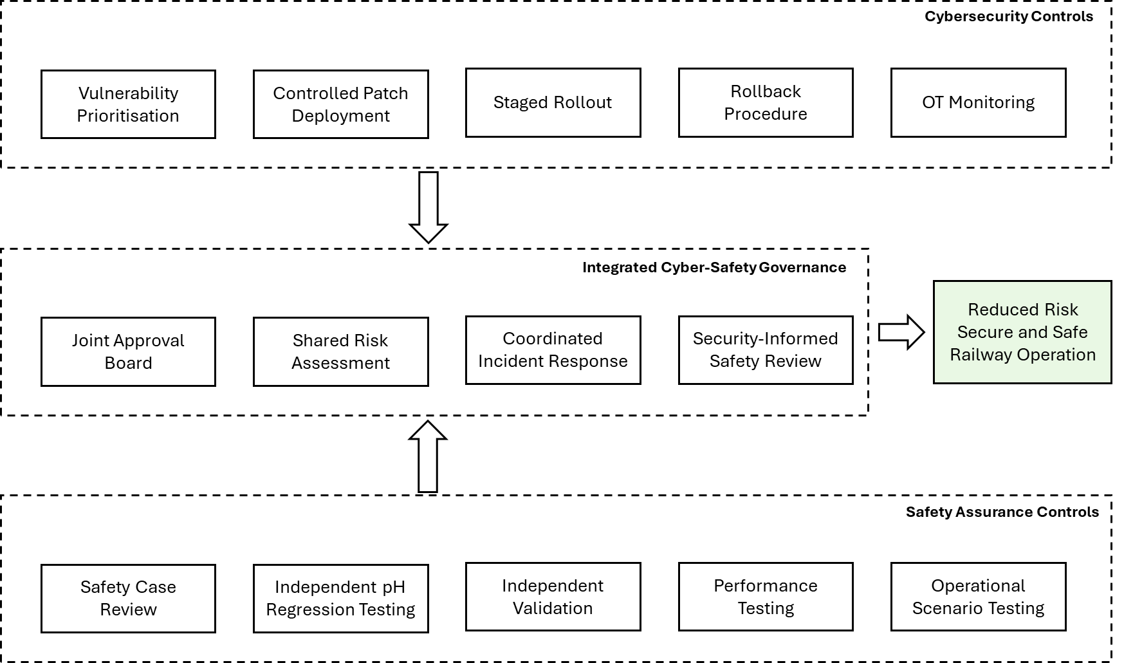
Security-Informed Safety Redesign

