Slide 1
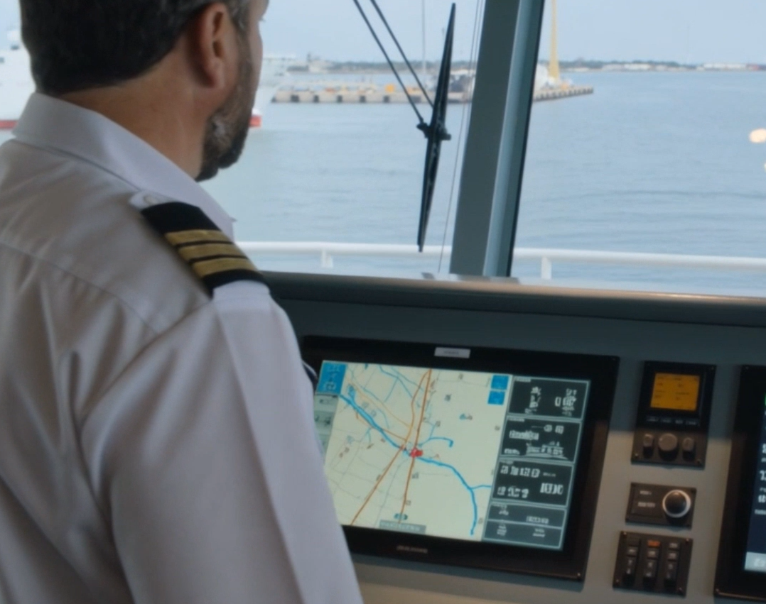
Security-Informed Safety
Episode 3
Maritime GPS Spoofing and Navigation Integrity Failure
CyBOK Funded Project
Author: Dr Hossein Abroshan

Slide 2
Learning Outcomes
After completing this episode, students should be able to:
Explain the role of GNSS in modern maritime navigation.
Describe how ECDIS, AIS, radar, speed logs and echo sounders support navigation.
Explain the difference between GNSS spoofing and GNSS jamming.
Understand how information integrity affects navigational safety.
Analyse how cyber-induced integrity failures influence operational decisions.
Identify resilience mechanisms used in maritime environments.
Apply Security-Informed Safety principles to navigation systems.

Slide 3
Maritime Navigation Architecture
Modern Bridge Systems
  Modern maritime navigation depends on multiple information sources:
  GNSS receivers
  ECDIS
  Radar / ARPA
  AIS
  Gyrocompass
  Speed log
  Echo sounder
  Bridge team oversight
Key Concept
Safe navigation depends on trustworthy information.

Slide 4
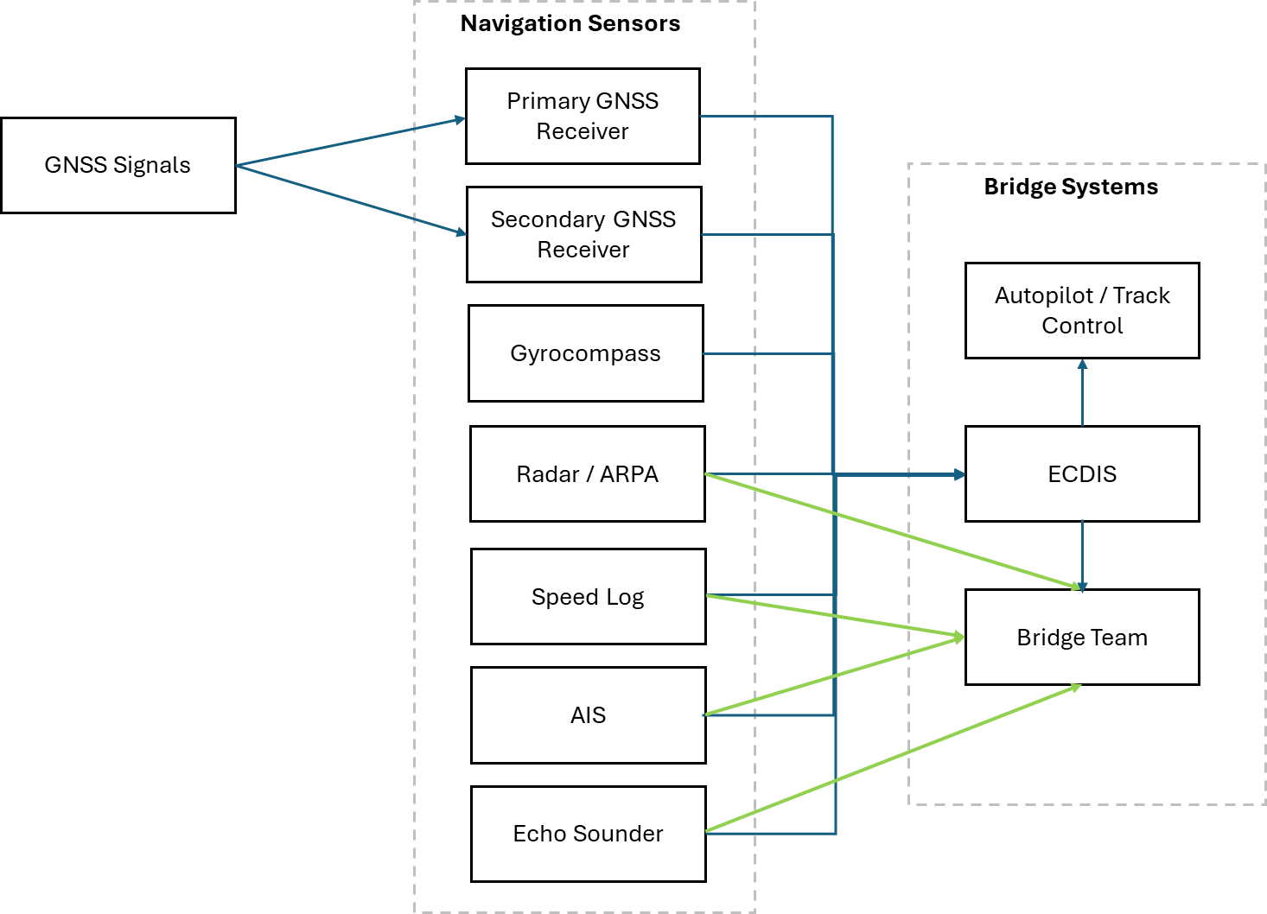
Maritime Navigation Architecture

Slide 5
Normal Navigation Operations
Safe Navigation Corridor
  Under normal conditions:
  The vessel follows a planned route.
  GNSS provides position information.
  ECDIS displays route progress.
  Radar confirms surrounding traffic and landmarks.
  Autopilot maintains the planned track.
  The bridge team monitors vessel status.
Key Concept
All systems present a consistent operational picture.

Slide 6
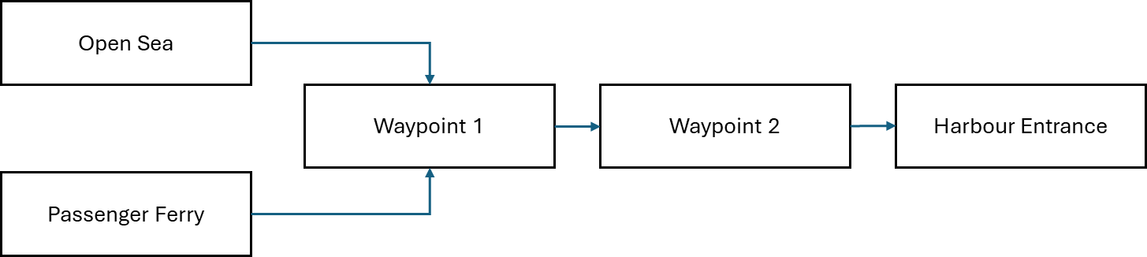
Normal Navigation Corridor

Slide 7
GNSS Spoofing Scenario
Information Integrity Attack
  Counterfeit GNSS signals are transmitted.
  Receivers continue operating normally.
  No obvious equipment failures occur.
  Position information appears plausible.
  Navigation displays remain operational.
  The bridge team sees an increasingly inaccurate picture.
Security-Informed Safety Principle
Cyber incidents can create hazards without damaging equipment.

Slide 8
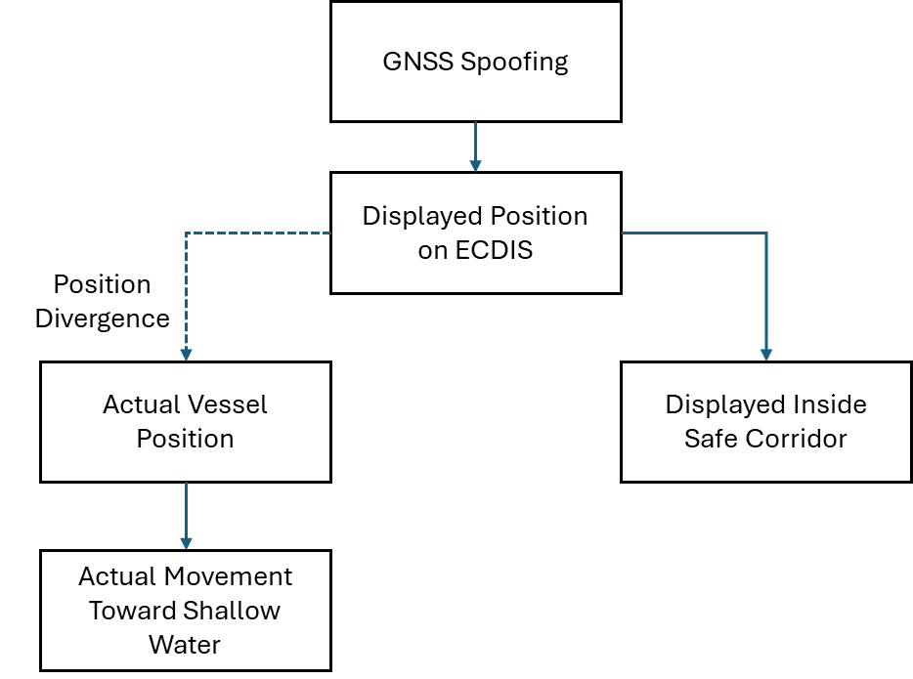
Divergence Between Displayed and Actual Position

Slide 9
Cyber-to-Physical Escalation
From False Position Data to Physical Hazard
GNSS Spoofing
False Position Data
Incorrect ECDIS Position
Incorrect Navigation Guidance
Vessel Drifts Toward Hazard
Grounding Risk
Potential Harm
Discussion Question
At what point does the cyber incident become a safety issue?

Slide 10
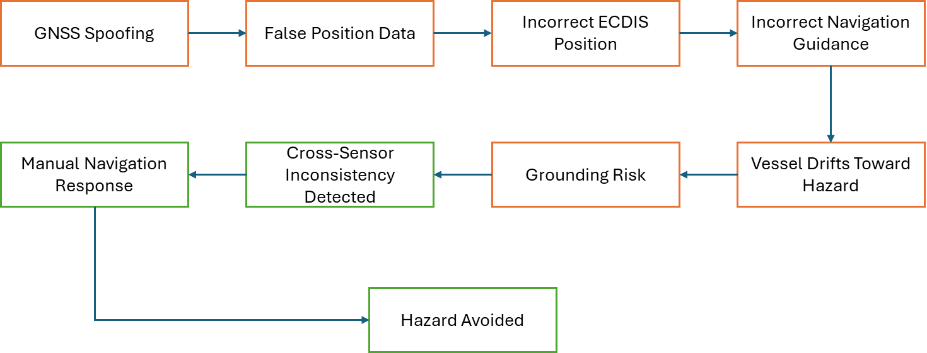
Cyber-to-Physical Escalation Pathway

Slide 11
Building Navigation Resilience
Mixed-Trust Sensor Environments
  Important resilience mechanisms include:
  Cross-sensor verification
  Radar observations
  Visual bearings
  Echo sounder verification
  GNSS integrity monitoring
  Diverse navigation sources
  Reduced-speed procedures
  Human oversight
Key Principle
No single navigation source should be assumed to be permanently trustworthy.

Slide 12
Security-Informed Safety
Key Lessons
Cyber attacks can influence physical operations without damaging equipment.
Information integrity is critical to safety.
Navigation systems require independent verification.
Human operators remain an essential safety barrier.
Defence-in-depth applies to navigation systems.
Resilience depends on diverse information sources.
Security-Informed Safety Principle:
Cyber events become safety hazards when compromised information influences operational decisions and physical system behaviour.
Discussion Questions
What was the hazard?
Why was the attack difficult to detect?
Which navigation sources remained trustworthy?
What role did the bridge team play?
How could resilience be improved?

