Slide 1
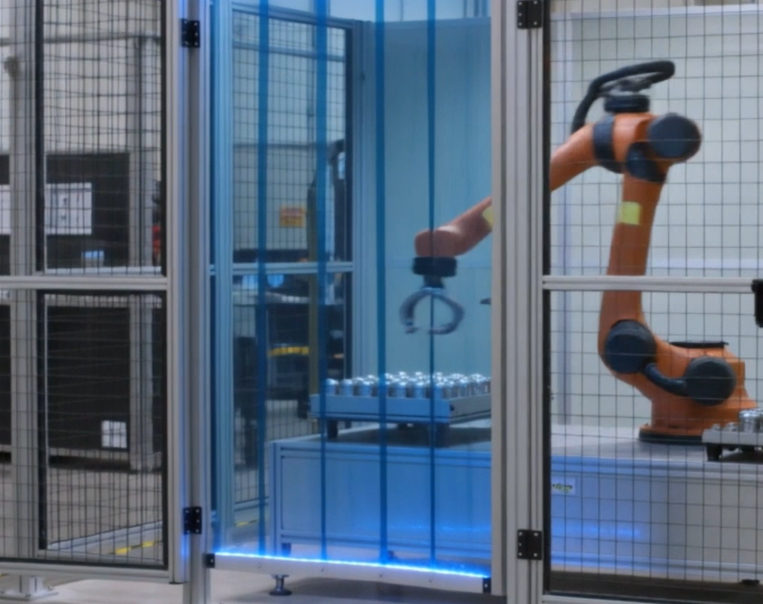
Security-Informed Safety
Episode 4
Smart Manufacturing Robot Cell Ransomware
CyBOK Funded Project
Author: Dr Hossein Abroshan

Slide 2
Learning Outcomes
After completing this episode, students should be able to:
Describe the safety architecture of a modern industrial robot cell.
Explain the functions of interlocked guards, light curtains, emergency stops, and safety PLCs.
Distinguish between operational disruption and safety hazards.
Explain how ransomware can indirectly create safety risks.
Identify unsafe restart conditions following a cyber incident.
Explain the importance of validating safety functions before recommissioning.
Analyse cross-functional decision-making during OT incident response.
Apply Security-Informed Safety principles to manufacturing environments.

Slide 3
Robot Cell Safety Architecture
Multiple Independent Safety Layers
  Industrial robot cells use several independent safety functions:
  Interlocked access gates
  Safety light curtains
  Emergency stop systems
  Safety PLC supervision
  Physical separation between personnel and hazardous motion
Key Concept
Safe operation depends on independent protection layers.

Slide 4
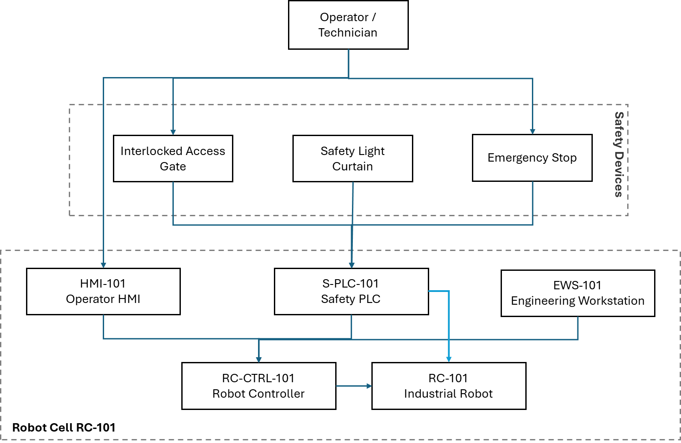
Robot Cell Safety Architecture (example)

Slide 5
Smart Manufacturing OT Environment
Information Supports Safe Operations
Modern manufacturing environments depend on:
Engineering workstations
HMIs
Manufacturing Execution Systems (MES)
Data historians
Identity services
Industrial communication networks
Operators rely on these systems to:
Understand machine status
Diagnose faults
Perform maintenance
Recover from abnormal conditions

Slide 6
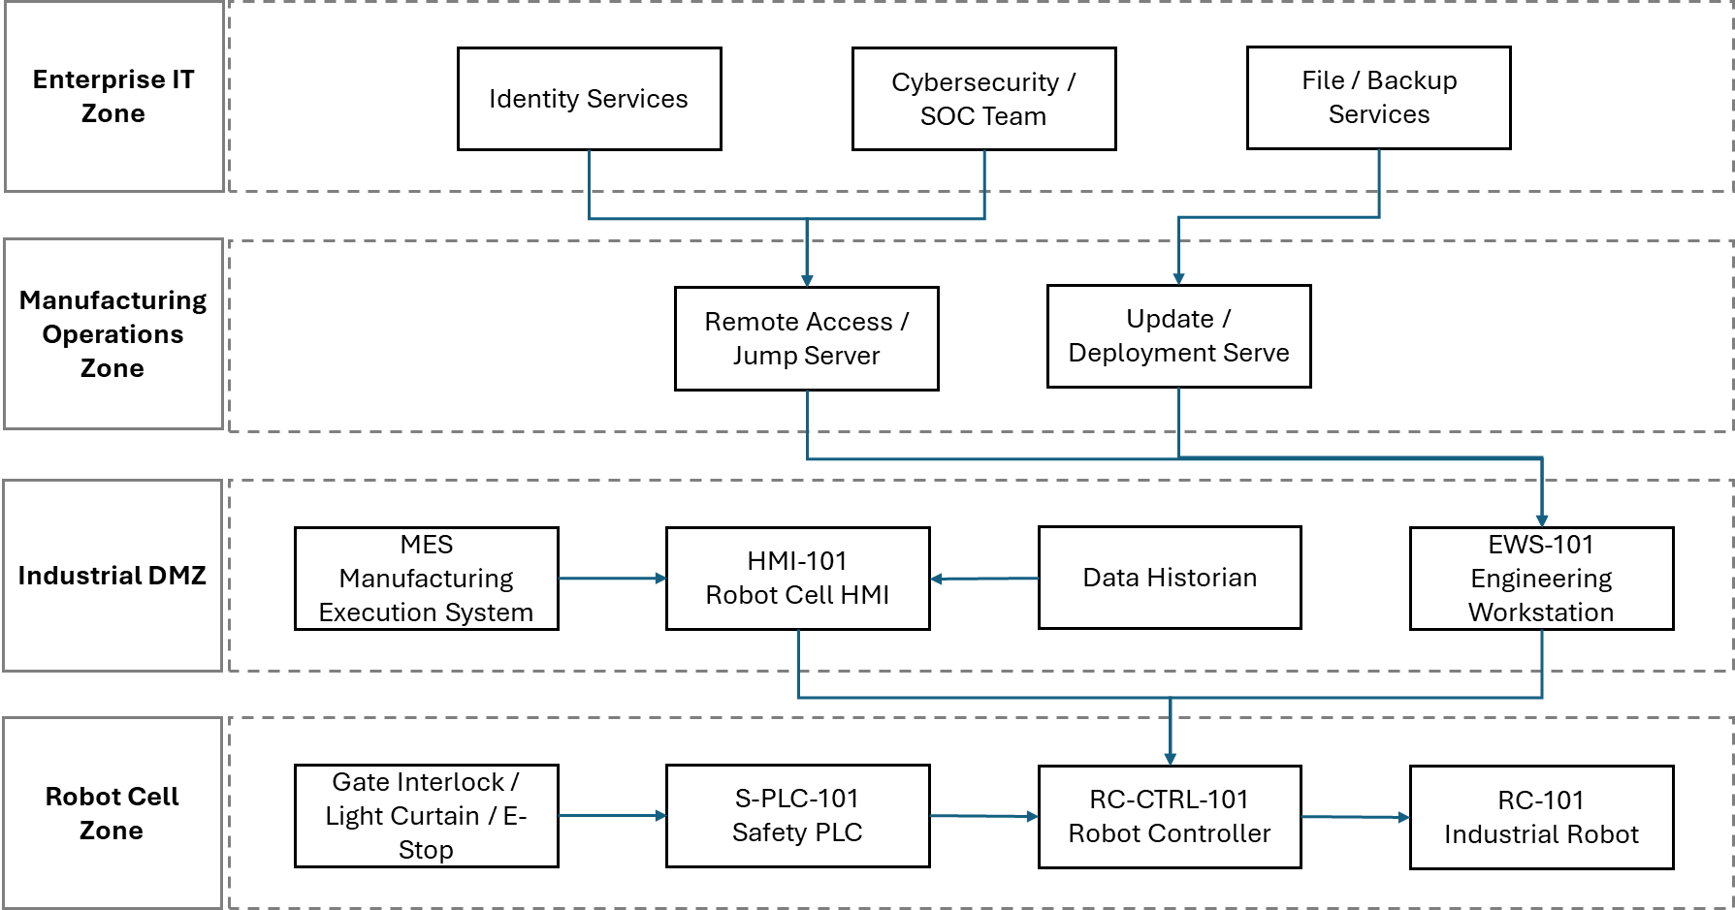
Smart Manufacturing OT Architecture

Slide 7
Ransomware Incident Scenario
What Actually Happens?
The ransomware incident affects:
User authentication services
Engineering workstations
Production monitoring systems
Historical process data
HMI availability
However:
The robot cell stops safely.
Safety systems remain operational.
No unsafe robot motion occurs.
Key Question
Can recovery decisions be trusted when operational information may no longer be trustworthy?

Slide 8
Cyber-to-Physical Escalation
From Cyber Incident to Safety Hazard
Ransomware Incident
Loss of Trusted Operational Information
Robot Cell Safe Stop
Production Pressure
Unsafe Restart Temptation
Incomplete Validation
Unexpected Robot Motion Hazard
Potential Injury or Equipment Damage
Discussion Question
At what point does the cyber security incident become a safety issue?

Slide 9
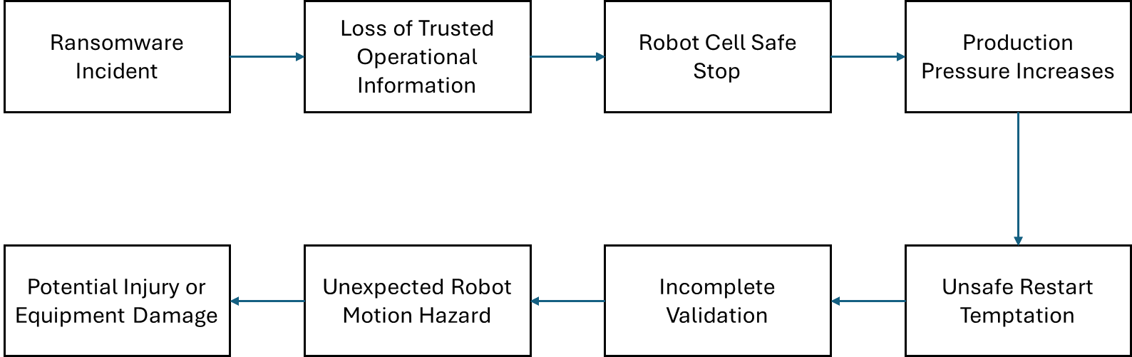
Cyber-to-Physical Escalation Pathway

Slide 10
Safe Recovery and Restart Governance
Recovery Requires More Than Technical Restoration
Before automatic production restart:
  Incident containment should be verified.
  Software integrity should be validated.
  Safety PLC diagnostics should be checked.
  Interlocks, light curtains and emergency stops should be tested.
  Physical inspection should be completed.
  Reduced-speed recommissioning should be performed.
Key Principle
Safe recovery requires evidence, not assumptions.

Slide 11
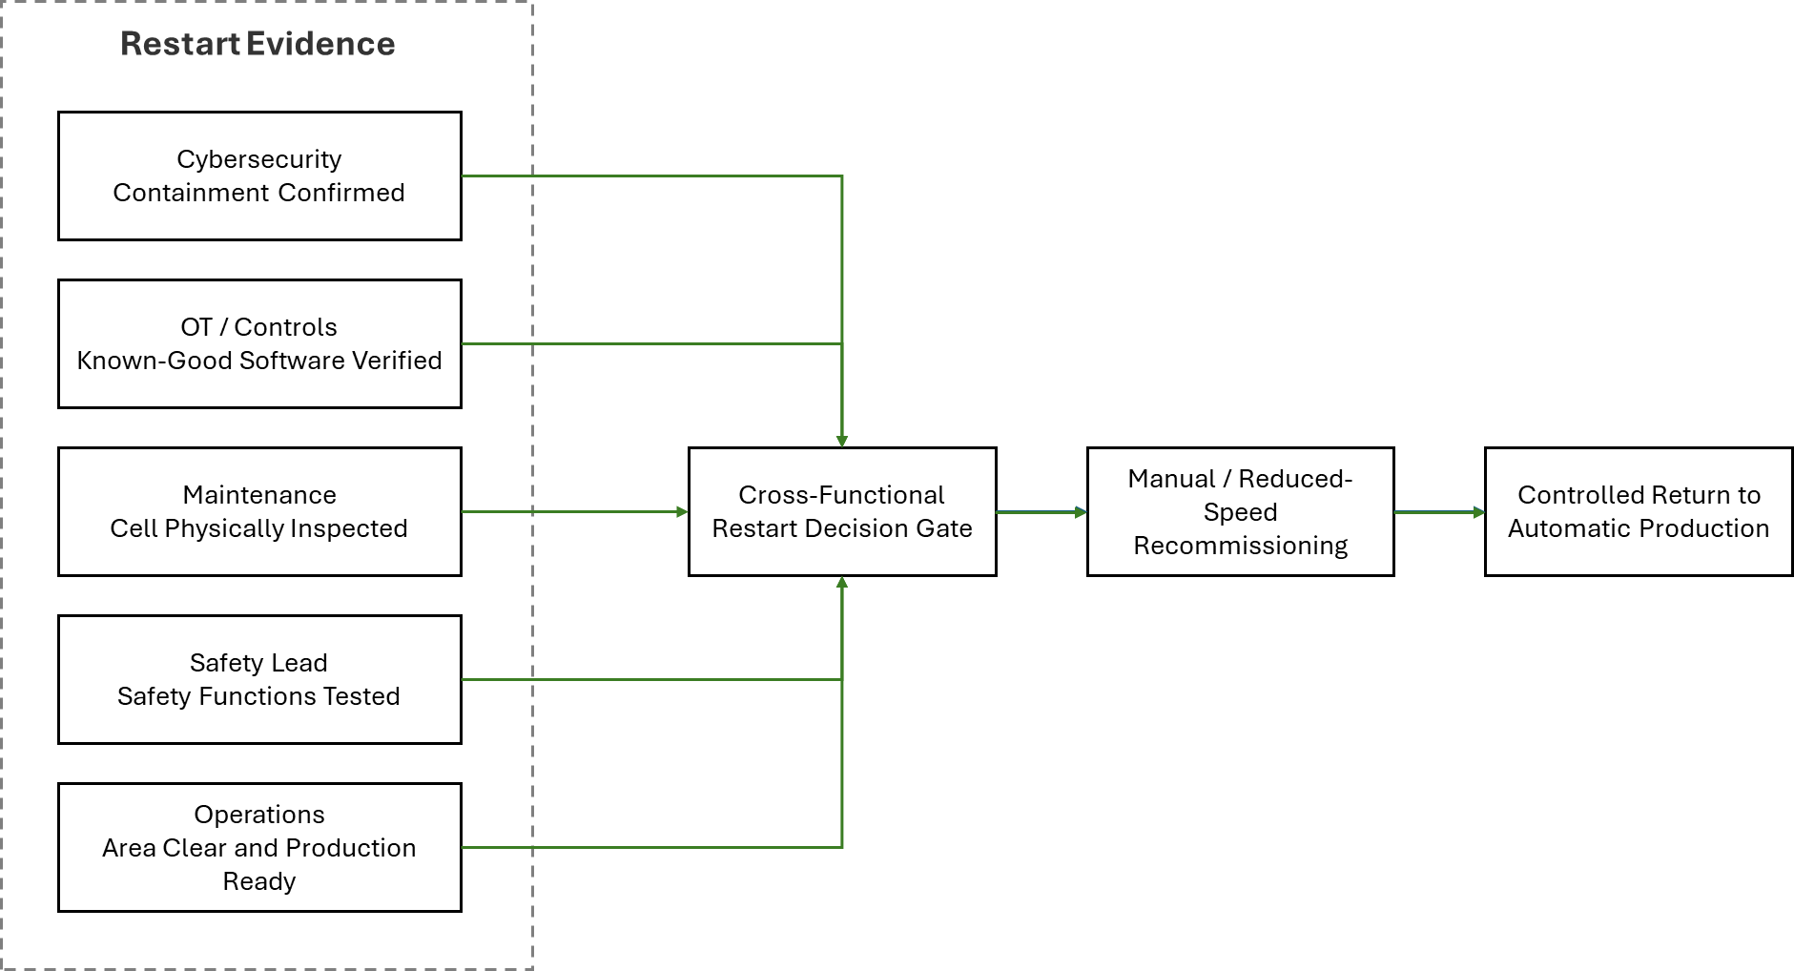
Cross-Functional Restart Decision Gate

Slide 12
Security-Informed Safety
Key Lessons
Ransomware can create safety risks without directly controlling equipment.
Loss of trusted information may be more dangerous than loss of availability.
Guard closure is not equivalent to safe restart.
Safety functions must be validated following cyber recovery.
Production pressure can influence safety-critical decisions.
Safe recovery requires cross-functional coordination.
Organisational culture plays an important role in resilience.
Security-Informed Safety Principle
It is not always safe to restart a system that has recovered from a cyber incident.
Discussion Questions
What was the hazard?
Why did the robot cell initially remain safe?
Why is restart governance important?
Which stakeholders should participate in recovery decisions?
How does co-design support Security-Informed Safety?

