Slide 1
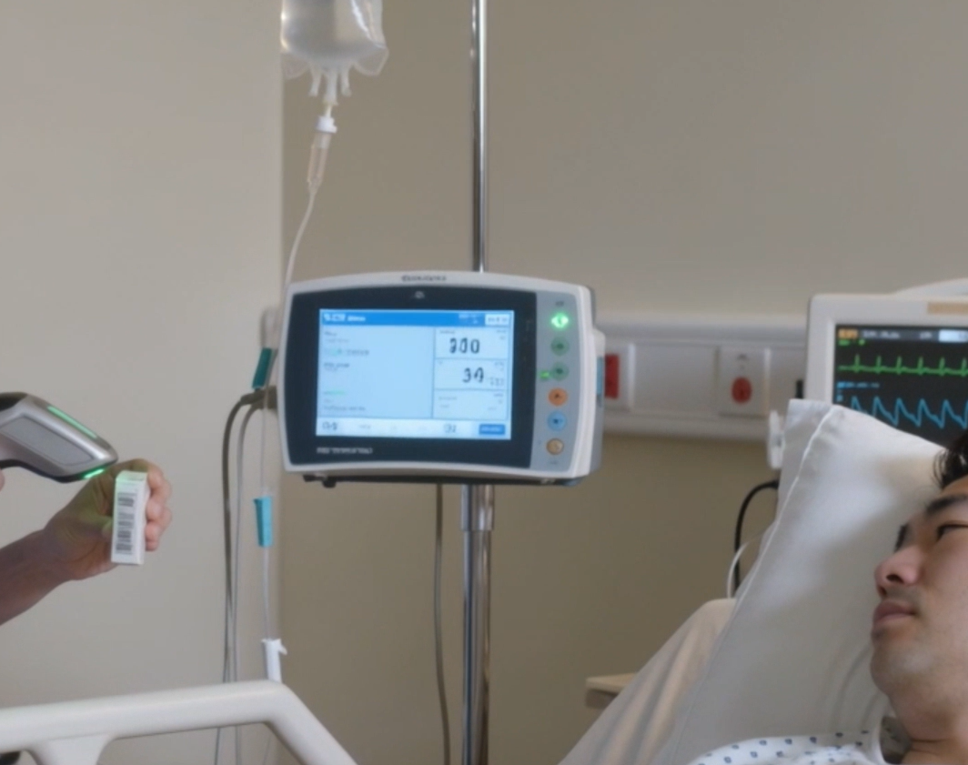
Security-Informed Safety
Episode 5
Cloud-Connected Infusion Pump Ecosystem Failure
CyBOK Funded Project
Author: Dr Hossein Abroshan

Slide 2
Learning Outcomes
After completing this episode, students should be able to:
Describe the architecture of a smart infusion pump ecosystem.
Explain the purpose of drug libraries and Dose Error Reduction Systems (DERS).
Distinguish between device failure and loss of operational assurance.
Explain how cyber incidents can indirectly affect patient safety.
Identify risks associated with degraded clinical workflows.
Explain the importance of resilience during healthcare service disruption.
Analyse cyber-to-physical escalation pathways in healthcare environments.
Apply Security-Informed Safety principles to connected medical technologies.

Slide 3
Connected Infusion Pump Ecosystem
Modern Healthcare Depends on Connected Systems
  Smart infusion pumps interact with:
  Drug Library Management Systems
  Dose Error Reduction Systems (DERS)
  Electronic Medication Administration Records (eMAR)
  Barcode Medication Administration (BCMA)
  Hospital wireless networks
  Fleet management platforms
  Vendor cloud services
Key Concept
Safe medication administration depends on both device functionality and trusted supporting information.

Slide 4
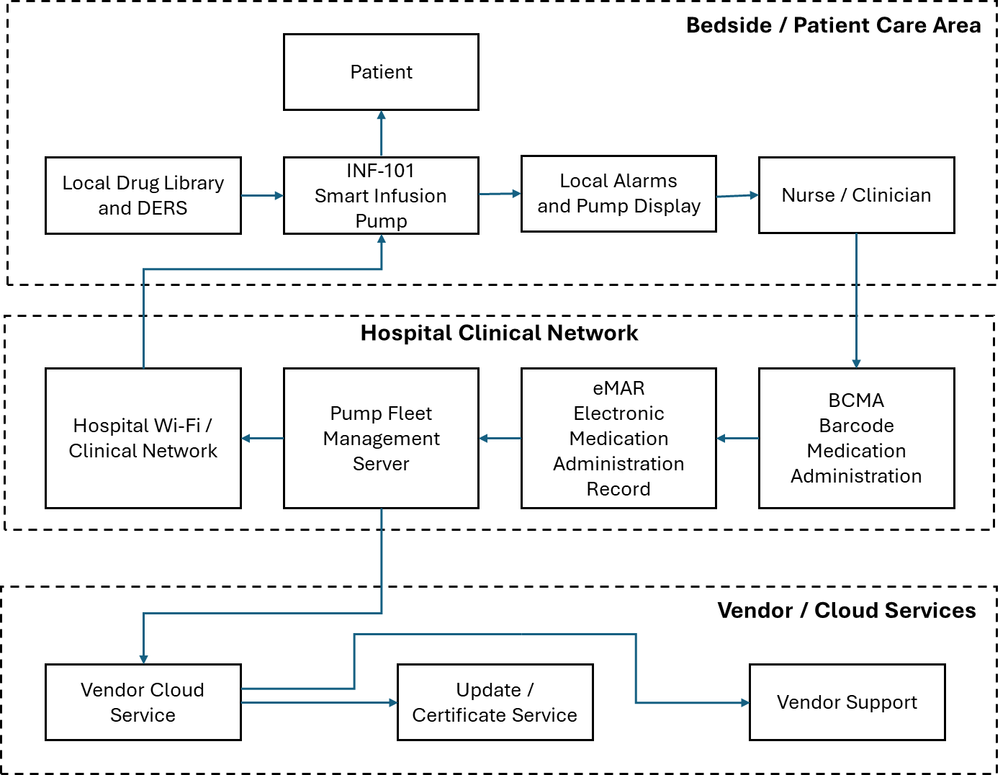
Connected Infusion Pump Ecosystem

Slide 5
Cloud Service Disruption Scenario
What Happens?
A cyber-related disruption affects connected services.
The disruption affects:
Drug library synchronisation
Fleet management visibility
Central alarm monitoring
Device status reporting
Remote administration functions
However:
Infusion pumps remain operational.
Active infusions continue.
Medication dosages are unchanged.
No immediate patient harm occurs.
Key Question
Can safe clinical operation continue when trusted digital assurance mechanisms become unavailable?

Slide 6
Cyber-to-Physical Escalation
From Service Disruption to Patient Risk
Cloud Service Disruption
Loss of Connected Clinical Services
Reduced Operational Visibility
Increased Reliance on Manual Procedures
Greater Potential for Human Error
Patient Safety Risk
Discussion Question
At what point does the cyber incident become a patient-safety issue?

Slide 7
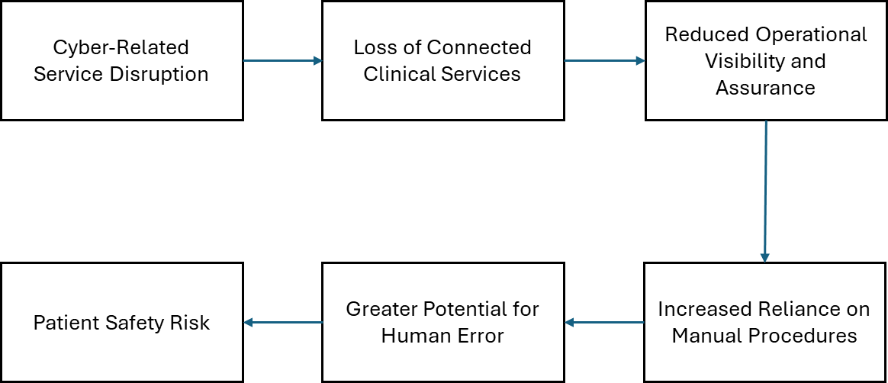
Cyber-to-Physical Escalation Pathway

Slide 8
Building Resilience During Degraded Operation
Safe Operation When Digital Services Are Unavailable
Important resilience mechanisms include:
  Independent medication verification
  Manual documentation procedures
  Additional peer-review checks
  Local device verification
  Clinical engineering support
  Cyber security response
  Vendor collaboration
  Human oversight
Key Principle
Digital systems support clinical decisions, but professional judgement remains the final safety barrier.

Slide 9
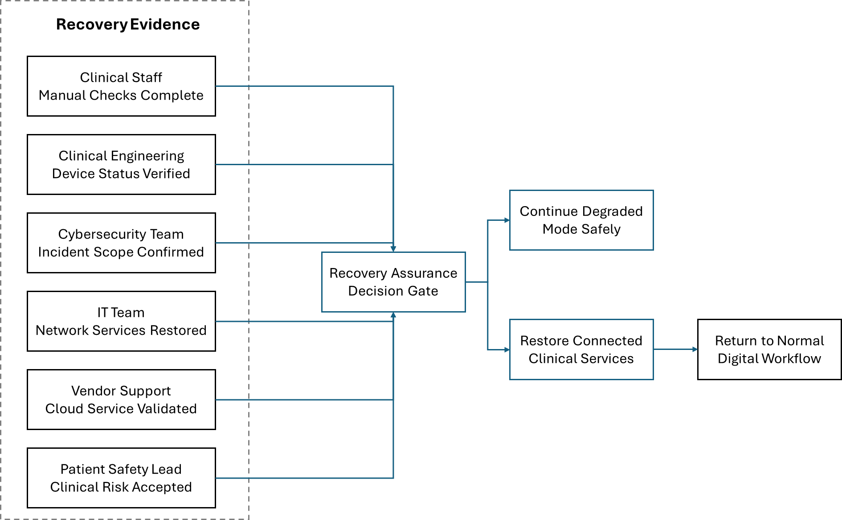
Coordinated Recovery and Assurance Framework

Slide 10
Security-Informed Safety
Key Lessons
Cyber incidents can create patient-safety risks without affecting device operation.
Loss of trusted information may be more significant than loss of functionality.
Healthcare resilience depends on safe operation during degraded conditions.
Manual workarounds introduce opportunities for human error.
Recovery decisions should be evidence-based and multidisciplinary.
Cyber security and patient safety cannot be treated as independent concerns.
Modern healthcare increasingly depends on trustworthy digital ecosystems.
Security-Informed Safety Principle
Patient safety depends not only on device functionality but also on the trustworthiness of the digital systems that support clinical decision-making.
Discussion Questions
What was the hazard?
Why did the infusion pumps continue operating safely?
Why is operational assurance important?
Which stakeholders should participate in recovery decisions?
How does resilience support patient safety?

